Slide 1
FedEx Assessment

Slide 2
Table of Content for Annexure
01 |  | How did you explore the data?
02 |  | How did you clean the data?
03 |  | How did you create the facts and dimensions and what was the reasoning behind it?
04 |  | How did you set up DBT?
05 |  | How did you set up DBT?
06 |  | How did you prepare your data for use in BI?
07 |  | How do you guarantee data quality?

Slide 3
How did you explore the data?
Used the source file to explore the data itself in terms of different aspects – be it firstly the schema, the attributes used, the context of the report, the type of columns, their data types, the types of values in each of the columns, the kind of questions we want to seek the answers to along with the sense of developing the warehouse model using Kimball way of data warehousing meant primarily for Star schema approach as required for this assessment.

Slide 4
How did you clean the data?
Rename columns for better readability
Handle missing values (fill or remove rows based on column importance)
Convert order date to datetime and handle any missing data in order date column plus data type issues with rest of the columns
Remove unnecessary columns (e.g., ‘Index’ and ‘Unnamed: 22’)
Remove unnecessary columns (e.g., ‘Index’ and ‘Unnamed: 22’)
Handling/Filtering data cases like Empty Courier Status, Blank Postal Code/Ship-City, Null Qty or Amount

Slide 5
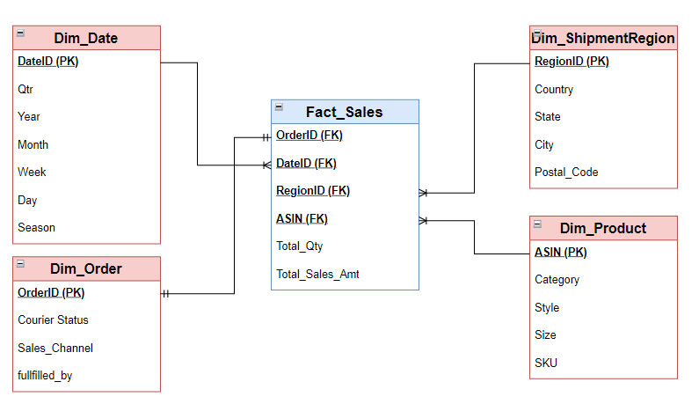
How did you create the facts and dimensions and what was the reasoning behind it?

Slide 6
How did you set up DBT?
Set Up the DBT Project and configure the snowflake server connection (profiles.yml)
Create Snowflake database and source tables with raw data for dimensions and fact table.
Create individual model files for each of the dimensions in the /models directory such as /models/dim_product.sql along with any additional transformations on raw tables.
Create the model for fact table using joins over different dimension models references.
Run the dbt models and test your transformation logic and flow.

Slide 7
How did you prepare your data for use in BI?
Once I do have the cleaned and transformed models on the gold layer, the option is to either use those table directly or create reporting tables/views based on the data size of the base tables and the business requirement.
Create pre-aggregated views in your data warehouse to reduce query times in BI tools based on the type of questions we want to seek answer to. For example: A view for sales by product category and style, A view for seasonal sales trends etc.
I would ensure that fact tables are optimized with appropriate partitioning or clustering or indexing to handle large volumes of data efficiently.
Ensure that data is clean for usage for BI purpose along with handling data duplicacy, Null/missing values etc.
Prepare and have the data ready in tables or materialized views based on the business use case.

Slide 8
How do you guarantee data quality?
We can use DBT models to create and define tests for uniqueness, completeness or referential integrity directly on both columns or the whole table itself.
We can create DBT data validations using custom sql scripts and run those models by integrating these into the DBT flow.
Setting up the notifications or error logs when the test fails.
DBT documentation and lineage can also help in making sure the data quality based on the models and their relationships and dependencies.

Slide 9
END

